Slide 1
New Zealand Adrian Jarvis
PCRN MEETING 2017 – CRVS for Disasters

Slide 2
Overview
97.7% of births within 1 year Request only 99.9% of deaths within 1 year
Medical cause of
Death 89.6%
Notes:
Birth Registration is estimated to be: 97.7% complete within 1 year of birth
99.1% of the total NZ born population is estimated to have had their birth registered. 75% of New Zealand residents were born in NZ at the 2012 census.
Birth certificates are not provided for all births and need to be requested.
Death Registration is estimated to be: 99.9% complete – within 1 year of death (less than 20 unregistered per year)
Cause of death (from a medical certificate) is provided for 89.6% of all deaths. 7.5% have cause of death from coroner, and remaining 2.9% have not been updated with coroner’s findings after 1 year. 98.7% of deaths have a cause of death from certificate or coroner within 5 years.
NZ have a CRVS group set up that meet 3 times a year. Members are from Internal Affairs, Ministry of Health and Statistics NZ.

Slide 3
DATA storage and Protection
Notes:
On this slide briefly describe
Where CR data is stored (centrally/ vs provincial or local office) – Central repository.
How records are stored - Electronic and/or paper records – Mostly electronic. Paper records are still submitted but are destroyed once data is captured electronically.
Whether data is backed up/ protected – off site/ local duplicate of the hard drive, copies of paper records? Data is backed up daily. Recent daily backups are stored onsite, but older backups are stored at an off-site location. Additionally data is sent to DR site (in a different geographical location) every few minutes.
How often the back up is done. Backups are done daily. Data transfer to DR site is every few minutes.

Slide 4
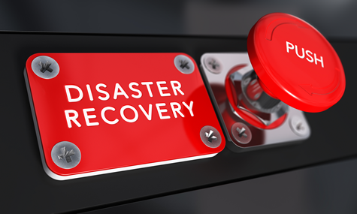
Major challenges FOR CRVS (pre and post Disaster)
Notes:
Testing our Lifedata Disaster Recovery (DR) site is a challenge for us because:
Quite often, DR is added as an after-thought solution without clear business objectives/ requirements defined. This leads to DR being mostly a technical solution without business use cases being developed properly.
A sound DR solution will consist of the following key elements:
- Technical solution to replicate data to secondary site
- A failover plan
- A failback plan
- Schedule routine tests (e.g once every 6 months or a year) to switch to DR and back to primary site
Both failover and failback plan will consist of technical and business process steps that describe how users can successfully connect to the DR site and then switch back to primary site. In our case, we’ve got a solution in place which replicates data successfully to the DR site but we unfortunately don’t have a failover/failback plan so cannot effectively test the DR site.

Slide 5
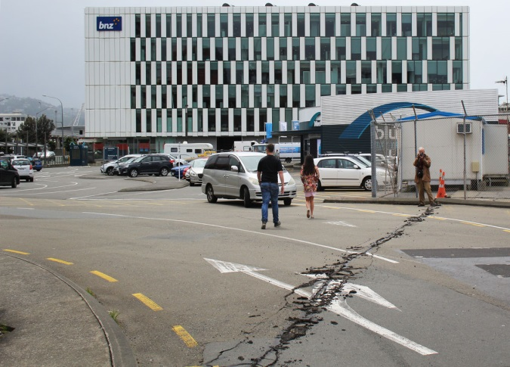
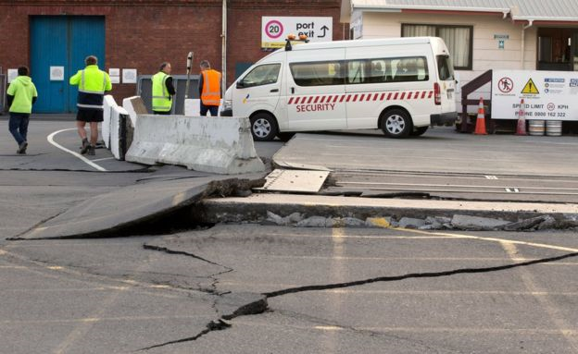
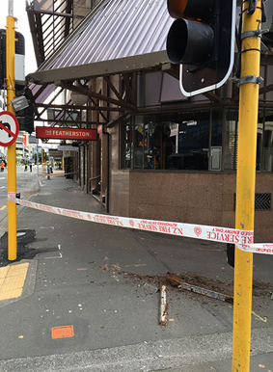
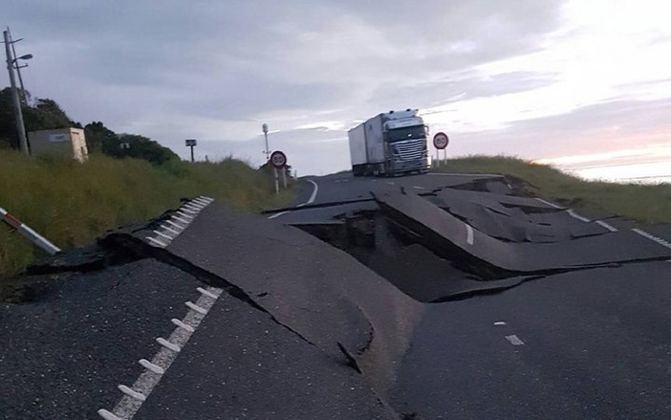
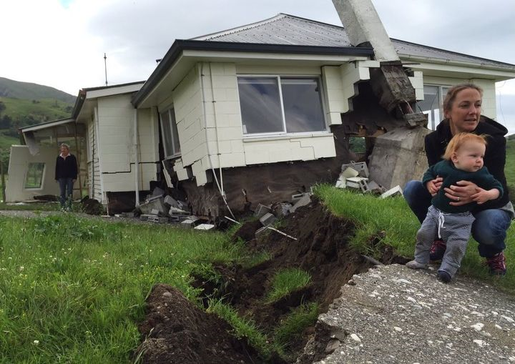
disaster scale up
Notes:
Describe BRIEFLY how your operation would cope with registration needs following a disaster.
Confident from a process perspective – Auckland Disaster Recovery site
System wise still needs to be tested
Tested on a small scale following Kaikoura earthquake in 2016
Main challenges with this were around our customers making contact with us with our Wellington Counter (face to face visits) being closed and our main Contact Centre being located in Wellington and the building it is housed in being closed.

